Slide 1


Master’s research project
Design, Implementation, and Evaluation of an Automotive Experimental Platform for Autonomous
Cooperative Adaptive Cruise Control (CACC)
Final presentation

Slide 2
Outlines
Introduction
Background
Building The Platform
Platform Performance Analysis and Summary
Conclusion and Future Improvements

Slide 3
Introduction
Personal Information
Objective and Motivation
Research Questions
Goals
Objective:
Build an experimental model for Autonomous Vehicles Platooning
Motivation:
Why do we need such a testbed?
What is the type of our research topic?
What should be done in order to bring our implementation to the real world?

Slide 4
Introduction
Personal Information
Objective and Motivation
Research Questions
Goals
Is it possible to build a small-scale testbed giving the provided funds?
Will this model produces useful –close to real-world- results?
Is it possible to control and monitor the platform and extract data from it?
Does that model have the capability to test different platooning techniques in terms of control and communication strategies?
Notes:
Which track and vehicles should be used as a Model? Are the hardware components going to fit inside the vehicle?
Which controller is better in terms of cost and efficiency? Does it supports Real-Time Operating System?
How to structure the software code and software layers?
Which building system shall be used?
Which communication modules and protocol can match the given requirement?
What measurements should be done? and what sensors are more suitable and should be used?
How to log data in order to be analyzed?
How to achieve remote control over the model?
What verification steps should be applied for each component of implemented
software and hardware?

Slide 5
Introduction
Personal Information
Objective and Motivation
Research Questions
Goals
1. A well-constructed and designed platform that can be used as a testbed (i.e., vehicles and road emulation).
2. Equipped with accurate sensors with proper sampling frequency.
3. Stable communication.
4. Real-time and efficient controller.
5. Additional features.
Notes:
1.1. Track should have a sufficient length and reliable shape.
1.2. Vehicles should be able to carry electronics and can be easily controlled on the track with the least effort.
________________________________________
3.1. Able to provide different communication and message passing schemes.
3.2. Preserve the Cooperative Awareness Message (CAM) refresh rate.
3.3. Works with minimum packet loss.
________________________________________
3.4. Deterministic communication behavior.
________________________________________
4. Real-time and efficient controller.
4.1. High controller frequency, to preserve the required control update rate.
4.2. Real-time software using Real-Time Operating System.
4.3. Atomic execution for critical sections (e.g., measuring relative distance)
________________________________________
5.1. Remote control and monitoring.
5.2. Multiple communication protocols such as ZigBee, & Wi-Fi, and Low Energy Bluetooth (BLE) to enable further research.
5.3. Data logging for post-processing analysis.

Slide 6
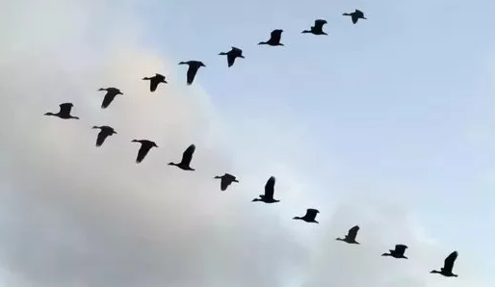
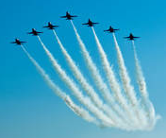
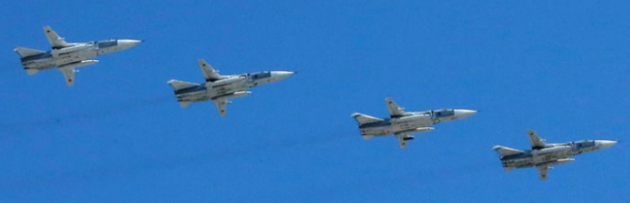
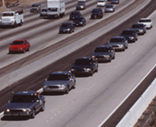
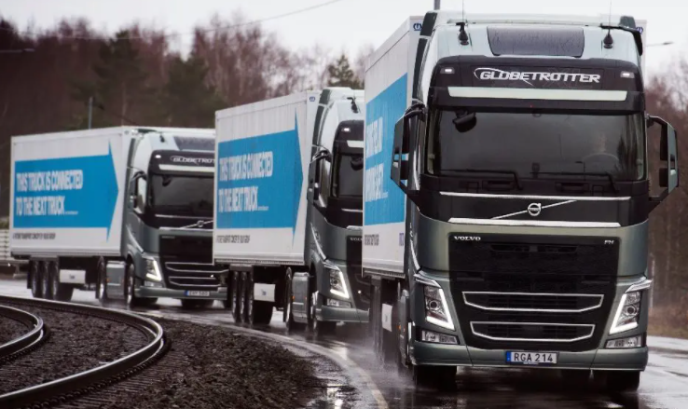
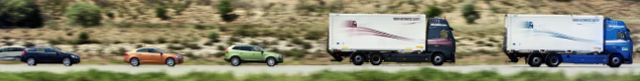
Background
Autonomous Platooning
Adaptive Cruise Control
Cooperative Adaptive Cruise Control
Control Methods
Wireless Communication
Flight jets platoon[2]
Birds platoon[1]
Flight jets platoon[3]
Vehicles platoon[4]
Trucks platoon[5]
Combined platoon[5]
Notes:
https://www.reddit.com/r/enlightenedbirdmen/comments/7qh831/my_new_platoon_chep/
https://texasnewstoday.com/russian-military-aircraft-are-practicing-bombing-enemy-ships-during-training-in-the-black-sea/344930/
https://www.merriam-webster.com/words-at-play/origin-of-squadron-and-squad
https://www.tech-faq.com/vehicle-platooning.html
https://erticonetwork.com/large-scale-deployment-of-multi-brand-truck-platooning-on-european-roads/

Slide 7
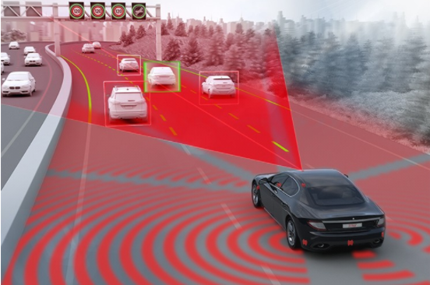
Background
Autonomous Platooning
Adaptive Cruise Control
Cooperative Adaptive Cruise Control
Control Methods
Wireless Communication
Stop & Go cruise control
Cruise control in curves
Speed limit-aware cruise control
Predictive adaptive cruise control
Parking speed control
ACC demonstration[6]
Turn-by-turn cruise control
Eco cruise control for fuel and EV capacity savings
Dynamic priority cruise control
ACC Types[7]
Notes:
https://www.zf.com/products/en/cars/products_30982.html
b

Slide 8
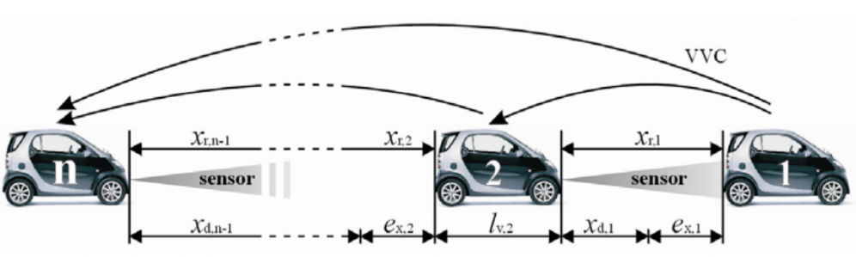
Background
Autonomous Platooning
Adaptive Cruise Control
Cooperative Adaptive Cruise Control
Control Methods
Wireless Communication
CACC demonstration[8], [9]
Notes:
https://www.aimsun.com/de/technische-hinweise/modellierung-verbundener-fahrzeuge-mit-aimsun-api/
Stephen Jones, N. Wikström, A. Ferreira Parrilla | DS | 29 November 2018 - Energy-Efficient Cooperative Adaptive Cruise Control (EECACC)

Slide 9
Background
Autonomous Platooning
Adaptive Cruise Control
Cooperative Adaptive Cruise Control
Control Methods
Wireless Communication
String stability
longitudinal control strategy.
Introduces the amplification of the spacing error among a string of vehicles (platoon).
Tries to attenuate spacing error.
It requires knowledge and data about more than the preceding vehicle
Notes:
https://www.aimsun.com/de/technische-hinweise/modellierung-verbundener-fahrzeuge-mit-aimsun-api/
Stephen Jones, N. Wikström, A. Ferreira Parrilla | DS | 29 November 2018 - Energy-Efficient Cooperative Adaptive Cruise Control (EECACC)

Slide 10
Background
Autonomous Platooning
Adaptive Cruise Control
Cooperative Adaptive Cruise Control
Control Methods
Wireless Communication
Wireless Communication
CAM message
Velocity
Time stamp (s)
Displacement
Acceleration
Target Velocity
Target Acceleration
Target Distance
Time stamp (micro-seconds)
Cooperative Awareness Message (CAM)
Specification:
Data rate
Packet loss
Delay
Behavior
Communication topology?
(e.g., Mesh topology)
Available options?
(e.g, Wi-Fi, Bluetooth, BLE, and ZigBee)

Slide 11
Background
Autonomous Platooning
Adaptive Cruise Control
Cooperative Adaptive Cruise Control
Control Methods
Wireless Communication
Accurate measurements for preceding vehicle relative distance, velocity
and acceleration.
Accurate measurements for the i_th vehicle displacement, velocity and acceleration.
Preserve CAM message interval of 100 ms.
Preserve controller frequency at 50 Hz (i.e., 20 ms).

Slide 12
Building The Platform
Defining Model Requirements
Components Selection
Software Implementation

Slide 13
Building The Platform
Defining Model Requirements
Components Selection
Software Implementation
Car Model and Track
Microcontroller
Selecting ZigBee Module
Sensors selection:
Speed measurements
Distance measurements
Power Supply
Motor Driver
Logic Analyzer
Vehicle Model:[10]
• Length:19 cm
• Height:4.5 cm
Custom Track:
• Maximum length of 6.3 m • Curvature length of 54 cm
Notes:
https://carrera-toys.com/de/product/20023902-bmw-m1-procar-no5-hockenheim-1979

Slide 14
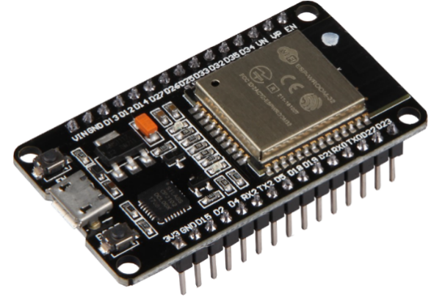
Building The Platform
Defining Model Requirements
Components Selection
Software Implementation
Car Model and Track
Microcontroller
Selecting ZigBee Module
Sensors selection:
Speed measurements
Distance measurements
Power Supply
Motor Driver
Logic Analyzer
NodeMCU ESP32[11]
CPU: low-power Xtensa® 32-bit LX6 microprocessor Dual core
CPU Clock: 240 MHz
Flash memory size: 4 MB
Peripherals: UART, SPI GPIO, I2C, I2S, I2C, LED PWM, Motor PWM, USB, pulse counter, capacitive touch sensor, ADC, DAC.
Wireless connectivity: Bluetooth, BLE, Wi-Fi, and ESP-NOW

Slide 15
Building The Platform
Defining Model Requirements
Components Selection
Software Implementation
Car Model and Track
Microcontroller
Selecting ZigBee Module
Sensors selection:
Speed measurements
Distance measurements
Power Supply
Motor Driver
Logic Analyzer
Core2530 SoC ZigBee module[12]
XBee usb extension compatible
Uses UART serial communication for data sharing.
Can be used as Coordinator, Router, End Device.
Works on 2.4 GHz, and supports up to 250kbps
21 GPIOs which makes it able to work as a minor MCU
Wide supply-voltage operating range (2 V–3.6 V).

Slide 16
Building The Platform
Defining Model Requirements
Components Selection
Software Implementation
Car Model and Track
Microcontroller
Selecting ZigBee Module
Sensors selection:
Speed measurements
Distance measurements
Power Supply
Motor Driver
Logic Analyzer
PMW3360 Laser sensor module[13]
Frame rate up to 12000 fps.
Uses SPI serial communication for data sharing.
Low latency, approximately (1 - 2) ms.
Can be easily configured to work with suitable resolution.
Acceptable velocity/acceleration up to 250 IPS/50g.
3.3V or 5V compatible
This selection was done after trials with other alternatives: Optical Shaft encoder, Reflective sensor (Groove IR, and Pololu QTR-8A)

Slide 17
Building The Platform
Defining Model Requirements
Components Selection
Software Implementation
Car Model and Track
Microcontroller
Selecting ZigBee Module
Sensors selection:
Speed measurements
Distance measurements
Power Supply
Motor Driver
Logic Analyzer
Distance measurement sensors[14]
Resolution: 2 mm.
Output type: Digital.
Low latency, approximately 1 ms.
Wide Angle: 15 degrees
Size: 45 × 21 mm.
Detection distance: 2cm-450cm
Input voltage: 5V.
Another alternative: VL53L0X ToF sensor

Slide 18
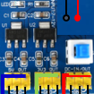
Building The Platform
Defining Model Requirements
Components Selection
Software Implementation
Car Model and Track
Microcontroller
Selecting ZigBee Module
Sensors selection:
Speed measurements
Distance measurements
Power Supply
Motor Driver
Logic Analyzer
LEDMO power adaptor[15], Power Converter
Supply voltage: 12 V
Supply current: 5 A
Component | Voltage level (V) | Current rating (mA) | Quantity
ESP32 | 3.3 | 1200 MAX | 3
Ultrasonic | 5 | 2 | 3
PMW3360 Laser sensor | 3.3 | 23 | 3
DEV8838 Motor driver | 11 | 200 | 3
Core2530 | 3.3 | 29 MAX | 3
Summary | Total current: |  | 4360
 | Voltage levels: |  | 5,3,3,11

Slide 19
Building The Platform
Defining Model Requirements
Components Selection
Software Implementation
Car Model and Track
Microcontroller
Selecting ZigBee Module
Sensors selection:
Speed measurements
Distance measurements
Power Supply
Motor Driver
Logic Analyzer
DRV8838 Brushed DC motor driver[16]
Motor supply voltage: 0 - 11V
Motor supply current: 1.7 A Max
Carrera Motors: 18 V, and about 100 mA[17]
Notes:
VIKING SCALEXTRIC SLOT CAR CLUB), to

Slide 20
Building The Platform
Defining Model Requirements
Components Selection
Software Implementation
Car Model and Track
Microcontroller
Selecting ZigBee Module
Sensors selection:
Speed measurements
Distance measurements
Power Supply
Motor Driver
Logic Analyzer
Saleae Logic 8[18]
8 Channels logic analyzer with capability of Analog and Digital signals capturing.

Slide 21
Building The Platform
Defining Model Requirements
Components Selection
Software Implementation
Communication Module
Interface with ESP-NOW
Mesh formation
Send/Receive API
Relative Motion Handler Module
Ultrasonic
Relative motion handler algorithm
Motion Handler Module
Laser Sensor
Own Vehicle motion handler algorithm
PWM Module
Motor Driver
Motor control APIs
FreeRTOS Module
Tasks Layers

Slide 22
Building The Platform
Defining Model Requirements
Components Selection
Software Implementation
Communication Module
Interface with ESP-NOW
Mesh formation
Send/Receive API
Relative Motion Handler Module
Ultrasonic
Relative motion handler algorithm
Motion Handler Module
Laser Sensor
Own Vehicle motion handler algorithm
PWM Module
Motor Driver
Motor control APIs
FreeRTOS Module
Tasks Layers

Slide 23
Building The Platform
Defining Model Requirements
Components Selection
Software Implementation
Communication Module
Interface with ESP-NOW
Mesh formation
Send/Receive API
Relative Motion Handler Module
Ultrasonic
Relative motion handler algorithm
Motion Handler Module
Laser Sensor
Own Vehicle motion handler algorithm
PWM Module
Motor Driver
Motor control APIs
FreeRTOS Module
Tasks Layers

Slide 24
Building The Platform
Defining Model Requirements
Components Selection
Software Implementation
Communication Module
Interface with ESP-NOW
Mesh formation
Send/Receive API
Relative Motion Handler Module
Ultrasonic
Relative motion handler algorithm
Motion Handler Module
Laser Sensor
Own Vehicle motion handler algorithm
PWM Module
Motor Driver
Motor control APIs
FreeRTOS Module
Tasks Layers

Slide 25
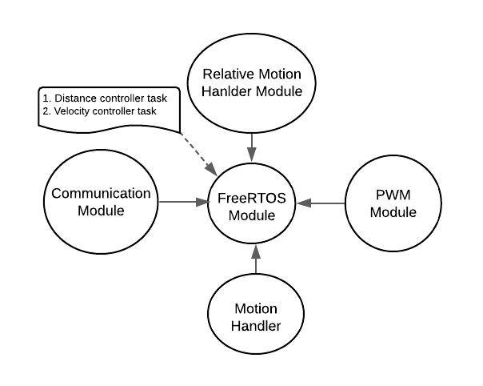
Building The Platform
Defining Model Requirements
Components Selection
Software Implementation
Communication Module
Interface with ESP-NOW
Mesh formation
Send/Receive API
Relative Motion Handler Module
Ultrasonic
Relative motion handler algorithm
Motion Handler Module
Laser Sensor
Own Vehicle motion handler algorithm
PWM Module
Motor Driver
Motor control APIs
FreeRTOS Module
Tasks Layers
Software Modules

Slide 26
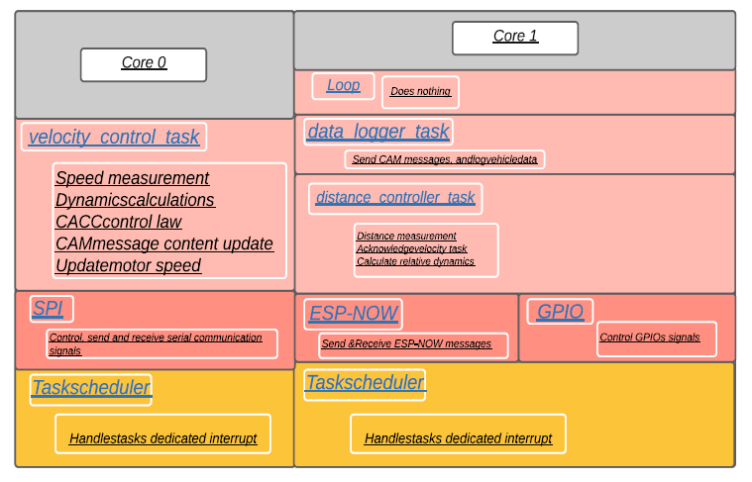
Building The Platform
Defining Model Requirements
Components Selection
Software Implementation
Communication Module
Relative Motion Handler Module
Motion Handler Module
PWM Module
FreeRTOS Module
Tasks Layers
Tasks layers for N_member

Slide 27
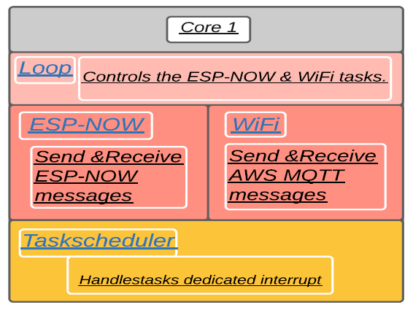
Building The Platform
Defining Model Requirements
Components Selection
Software Implementation
Communication Module
Relative Motion Handler Module
Motion Handler Module
PWM Module
FreeRTOS Module
Tasks Layers
Tasks layers for logNode

Slide 28
Building The Platform
Hardware Schematic
Hardware Implementation
Additional Features
Hardware connections

Slide 29
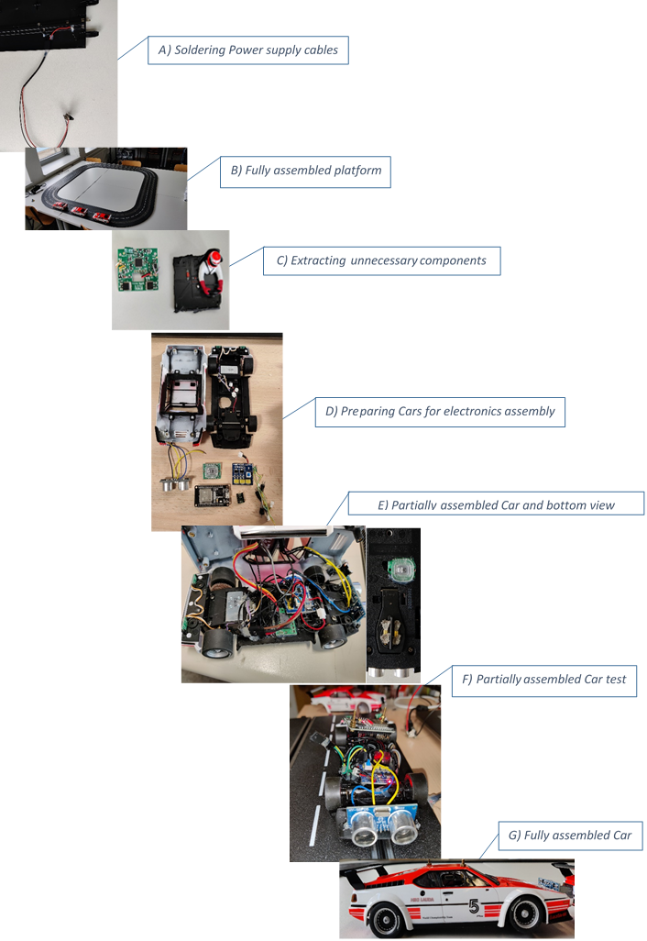
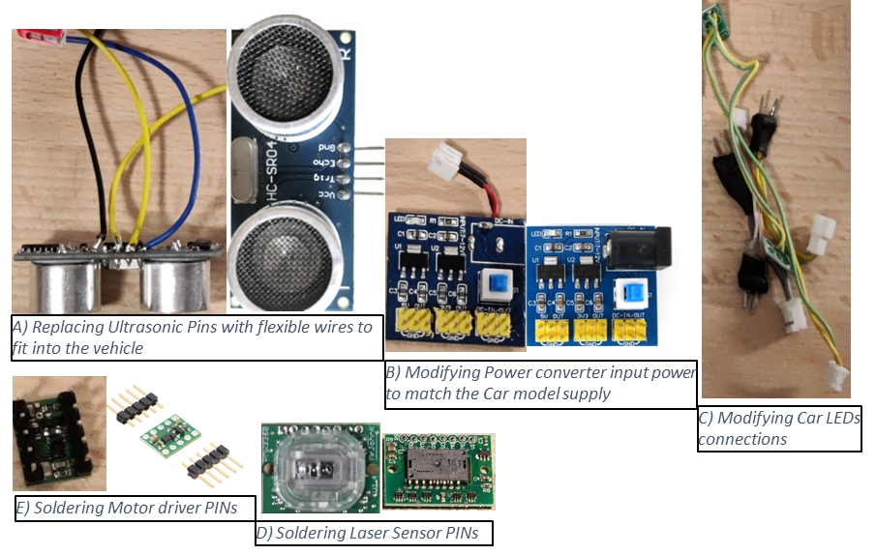
Building The Platform
Hardware Schematic
Hardware Implementation
Additional Features
Components preparation process
Platform assembly process

Slide 30
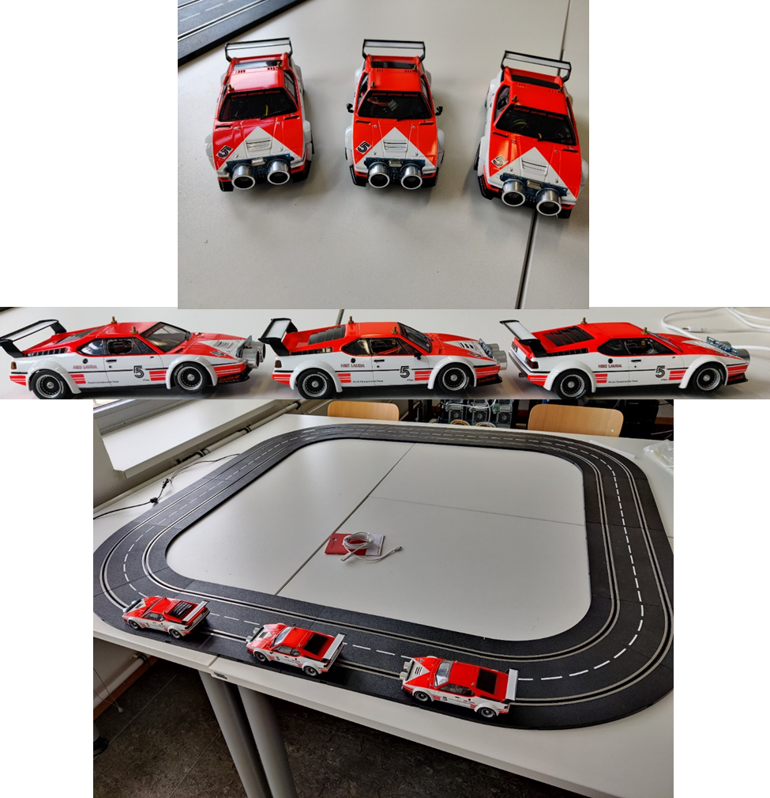
Building The Platform
Hardware Schematic
Hardware Implementation
Additional Features
Finally assembled platform

Slide 31
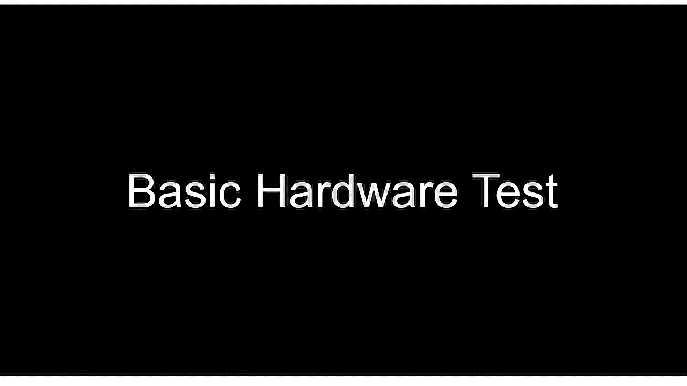
Building The Platform
Hardware Schematic
Hardware Implementation
Additional Features

Slide 32
Building The Platform
Hardware Schematic
Hardware Implementation
Additional Features
MQTT and remote control
System Configuration File
2 D.O.F debugging
Automated Scripts
ESP-NOW Mesh and remote control communication topology

Slide 33
Building The Platform
Hardware Schematic
Hardware Implementation
Additional Features
MQTT and remote control
System Configuration File
2 D.O.F debugging
Automated Scripts
Python UI

Slide 34
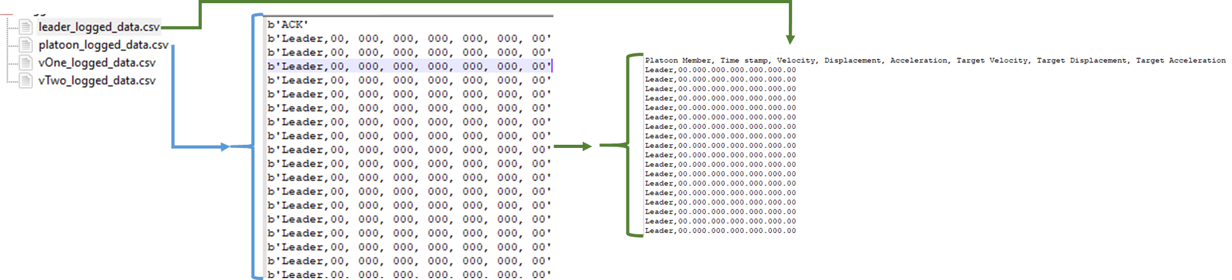
Building The Platform
Hardware Schematic
Hardware Implementation
Additional Features
MQTT and remote control
System Configuration File
2 D.O.F debugging
Automated Scripts
Logged data handling

Slide 35
Building The Platform
Hardware Schematic
Hardware Implementation
Additional Features
MQTT and remote control
System Configuration File
2 D.O.F debugging
Automated Scripts
Code Snippet from System Configuration File

Slide 36
Building The Platform
Hardware Schematic
Hardware Implementation
Additional Features
Debugging
Modules’ debugging
MQTT and remote control
System Configuration File
2 D.O.F debugging
Automated Scripts
Automated Scripts
Platoon_run.bat
Velocity_profile_parser.py
Generate_velocity_profile.m

Slide 37
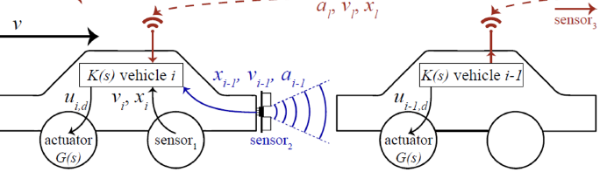
Platform Performance Analysis and Summary
[Simulation] Preceding Vehicle Motion Analysis
[Simulation] Motion Analysis Within The Vehicle
CAM Messages
Controller Frequency Preservation
Remote Commands
(Jeroen Ploeg, 2011)
Analysis preparation:
Assumptions:
Leader vehicle velocity assumed to be constant, and a spacing error profile was estimated. This profile represents an ideal sensor measurements in analog world.
According to the estimated profile, an estimated velocity and acceleration was also evaluated
Error injection:
Sensor error (1.04 – 1.1).
Discretization.
Assuming that the distance controller task is repeated every 10 ms

Slide 38
Platform Performance Analysis and Summary
[Simulation] Preceding Vehicle Motion Analysis
[Simulation] Motion Analysis Within The Vehicle
CAM Messages
Controller Frequency Preservation
Remote Commands
Observations:
Control parameters are: Sampling interval, averaging buffer size, and sensor errors.
Optimum buffer size for velocity is 3 - 5, as for acceleration up to 20 gives promising results.
Increasing sampling frequency improves velocity profile, but acceleration profile becomes more noisy.
_________________________________________________________
Generally, the results are promising, yet needs to be verified on the Embedded target.

Slide 39
Platform Performance Analysis and Summary
[Simulation] Preceding Vehicle Motion Analysis
[Simulation] Motion Analysis Within The Vehicle
CAM Messages
Controller Frequency Preservation
Remote Commands

Slide 40
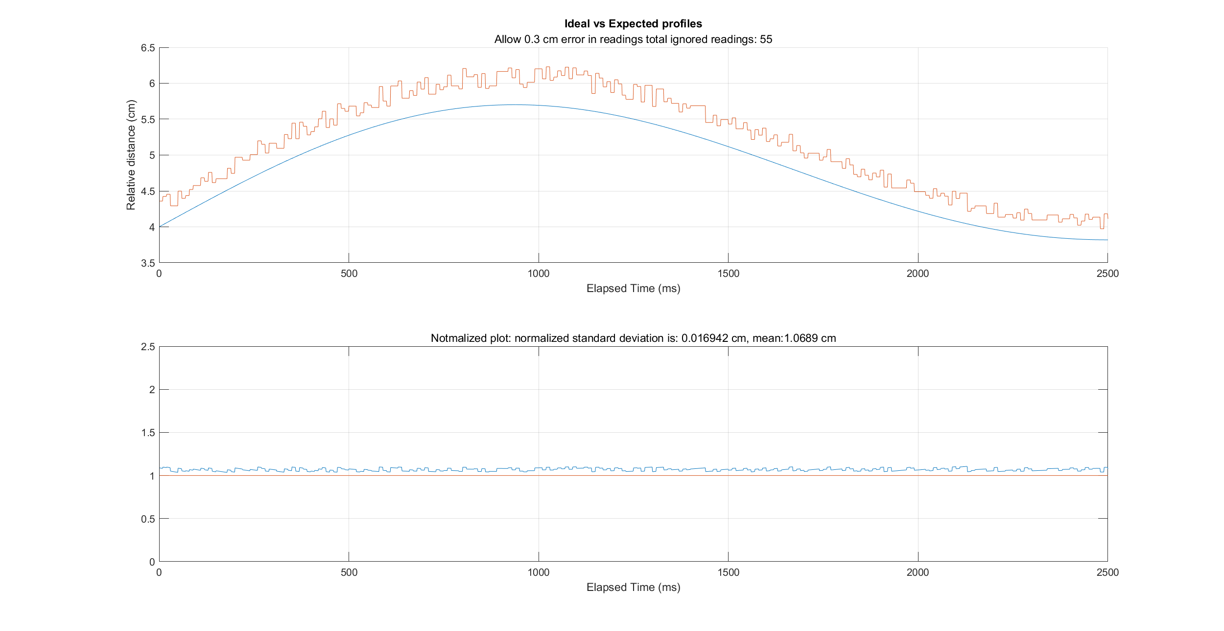
Platform Performance Analysis and Summary
[Simulation] Preceding Vehicle Motion Analysis
[Simulation] Motion Analysis Within The Vehicle
CAM Messages
Controller Frequency Preservation
Remote Commands

Slide 41
Platform Performance Analysis and Summary
[Simulation] Preceding Vehicle Motion Analysis
[Simulation] Motion Analysis Within The Vehicle
CAM Messages
Controller Frequency Preservation
Remote Commands

Slide 42
Platform Performance Analysis and Summary
[Simulation] Preceding Vehicle Motion Analysis
[Simulation] Motion Analysis Within The Vehicle
CAM Messages
Controller Frequency Preservation
Remote Commands

Slide 43
Platform Performance Analysis and Summary
[Simulation] Preceding Vehicle Motion Analysis
[Simulation] Motion Analysis Within The Vehicle
CAM Messages
Controller Frequency Preservation
Remote Commands
(Jeroen Ploeg, 2011)
Analysis preparation:
Assumptions:
Vehicle velocity assumed.
According to the estimated profile, an estimated velocity and acceleration was also evaluated
Error injection:
Sensor error (1.04 – 1.32).
Discretization.
Assuming that the velocity controller task is repeated every 10 ms

Slide 44
Platform Performance Analysis and Summary
[Simulation] Preceding Vehicle Motion Analysis
[Simulation] Motion Analysis Within The Vehicle
CAM Messages
Controller Frequency Preservation
Remote Commands
Observations:
Increasing the sampling interval has a huge effect for velocity estimation accuracy different than the previous test.
Acceleration requires noise filter.
Optimum average buffer size for velocity is 3 - 5, while in acceleration starts from 20..
Increasing sampling frequency improves velocity profile, but acceleration profile becomes more noisy.
_________________________________________________________
A constant shift in the velocity profile due to accumulated error in displacement measurements. As for the acceleration it shows a promising profile with 20 points average buffer size, however this comes the price of increasing computation time.

Slide 45
Platform Performance Analysis and Summary
[Simulation] Preceding Vehicle Motion Analysis
[Simulation] Motion Analysis Within The Vehicle
CAM Messages
Controller Frequency Preservation
Remote Commands

Slide 46
Platform Performance Analysis and Summary
[Simulation] Preceding Vehicle Motion Analysis
[Simulation] Motion Analysis Within The Vehicle
CAM Messages
Controller Frequency Preservation
Remote Commands

Slide 47
Platform Performance Analysis and Summary
[Simulation] Preceding Vehicle Motion Analysis
[Simulation] Motion Analysis Within The Vehicle
CAM Messages
Controller Frequency Preservation
Remote Commands
Test case:
2 MCUs were set to represent Leader and Vehicle One operation, One controller sends a CAM data each 100 ms, and the receiving controller sends another CAM message once a new messages is received from the leader MCU, the latency is calculated in terms of microseconds.
No. of Sent messages | No. of acks Packet | loss %
6344 | 6330 | 0.22%
Average CAM delivery:
Varies from 100 - 104 ms which is a very satisfying result
CAM message test results

Slide 48
Platform Performance Analysis and Summary
[Simulation] Preceding Vehicle Motion Analysis
[Simulation] Motion Analysis Within The Vehicle
CAM Messages
Controller Frequency Preservation
Remote Commands
Test case:
Distance (i.e., Ultrasonic task):
Adding computation time for the motion analysis algorithm, the latency was in the range of (9 ms up to 16 ms)
2. Velocity (i.e., laser sensor task):
Average task latency was in range from (11 ms up to 20 ms).

Slide 49
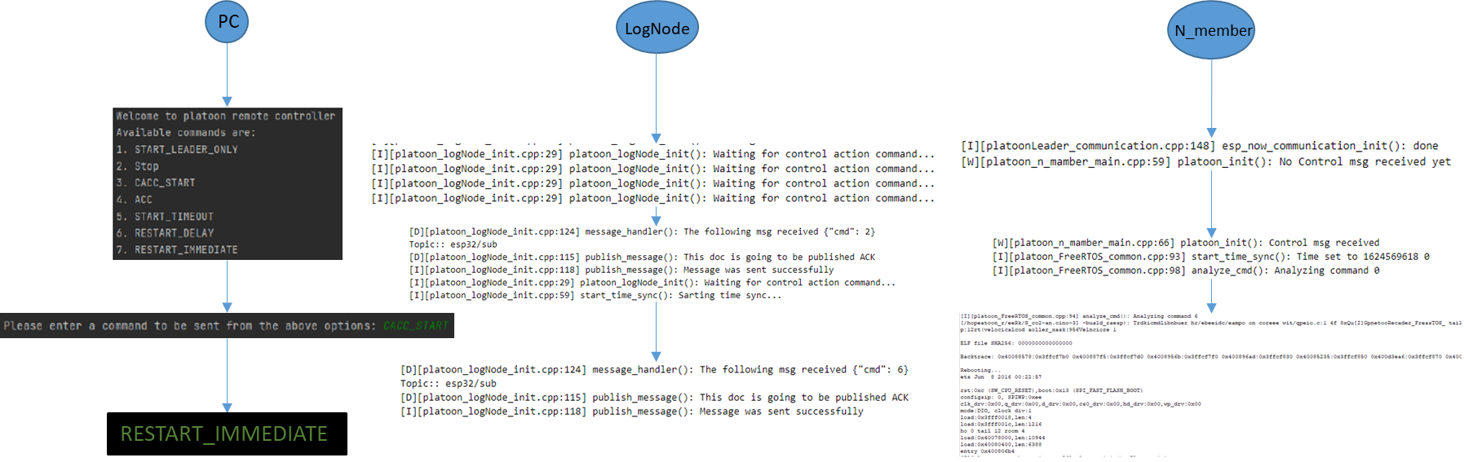
Platform Performance Analysis and Summary
[Simulation] Preceding Vehicle Motion Analysis
[Simulation] Motion Analysis Within The Vehicle
CAM Messages
Controller Frequency Preservation
Remote Commands
Remote control test

Slide 50
Conclusion
Recall: Research Question
Is it possible to build a small-scale testbed giving the provided funds?
Will this model produces useful –close to real-world- results?
Is it possible to control and monitor the platform and extract data from it?
Does that model have the capability to test different platooning techniques in terms of control and communication strategies?

Slide 51
Conclusion
Software structure and Building system
MCU
Measurements and Sensors
Check List
Track and vehicles
Communication modules/protocols
Verification steps
Data logging
Remote control

Slide 52
Future Improvements
Sustainable CACC testbed
Hardware and wiring
Port Extended Kalman Filter (EKF)
Implement the CACC control law for each platoon member
Remote action commands
Python UI script can be improved
Streaming Camera installation
Major Improvements
Estimation Algorithms
Minor Improvements
Software architecture
Dedicated IMU sensor

Slide 53

Thank you! Questions?

